Slide 1
ST 551: Statistical Methods I Fall 2023
Lecture 21: November 27, 2023

Slide 2
Transformations
Many of the methods we have considered (and that you will consider in upcoming courses) are exact only when the underlying population distribution is normal
t-test, ANOVA, Linear Regression
(Otherwise these methods are asymptotically exact, since all of these methods perform inference based on sample means/sums)
For highly skewed (asymmetric) population distributions, large sample sizes may be required to achieve reasonable calibration

Slide 3
Transformations
Some sources recommend transforming data to improve the approximation of normality (reduce asymmetry) and make the Normal-based methods perform more exactly
Commonly used transformations:
These transformations are only appropriate for positive data.
Data with negative values can be shifted up first to obtain all positive values.

Slide 4
Transformations
Some sources recommend transforming data to improve the approximation of normality (reduce asymmetry) and make the Normal-based methods perform more exactly
Commonly used transformations:

Slide 5
Transformations
“Many biological variables do not meet the assumptions of parametric statistical tests: they are not normally distributed, the variances are not homogeneous, or both. Using a parametric statistical test (such as an anova or linear regression) on such data may give a misleading result. In some cases, transforming the data will make it fit the assumptions better.”
http://www.dmi.units.it/~inverniz/adir/stattransform.html

Slide 6
Transformations
“…if the population is substantially skewed and the sample size is at most moderate, the approximation provided by the central limit theorem can be poor, and the resulting confidence interval will likely have the wrong coverage probability. Thus, when there is evidence of substantial skew in the data, it is common to transform the data to a symmetric distribution before constructing a confidence interval. If desired, the confidence interval can then be transformed back to the original scale using the inverse of the transformation that was applied to the data.”
https://en.wikipedia.org/wiki/Data_transformation_%28statistics%29

Slide 7
Transformations
“…if the population is substantially skewed and the sample size is at most moderate, the approximation provided by the central limit theorem can be poor, and the resulting confidence interval will likely have the wrong coverage probability. Thus, when there is evidence of substantial skew in the data, it is common to transform the data to a symmetric distribution before constructing a confidence interval. If desired, the confidence interval can then be transformed back to the original scale using the inverse of the transformation that was applied to the data.”
https://en.wikipedia.org/wiki/Data_transformation_%28statistics%29

Slide 8
Transformations
Testing hypotheses regarding population means on the original data can answer a different question than testing hypotheses regarding population means of transformed data: for instance,
Transforming inference back to the original scale is very challenging to interpret unless strong assumptions are made

Slide 9
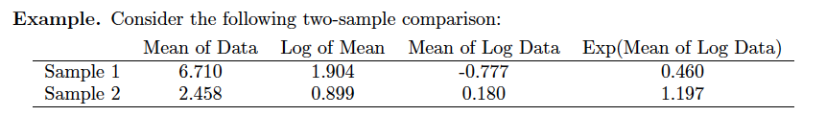
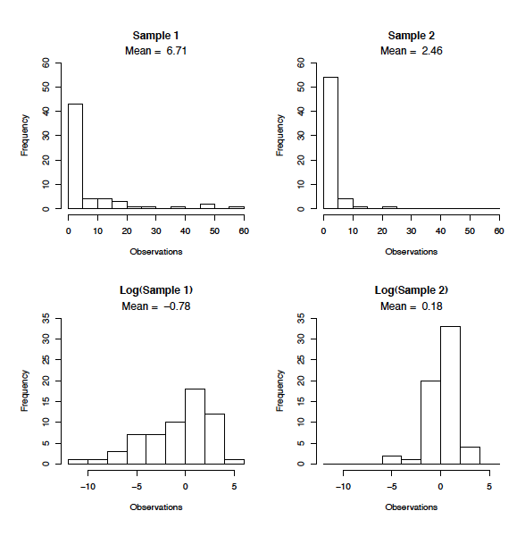
Transformations

Slide 10
Transformations

Slide 11
Transformations

Slide 12
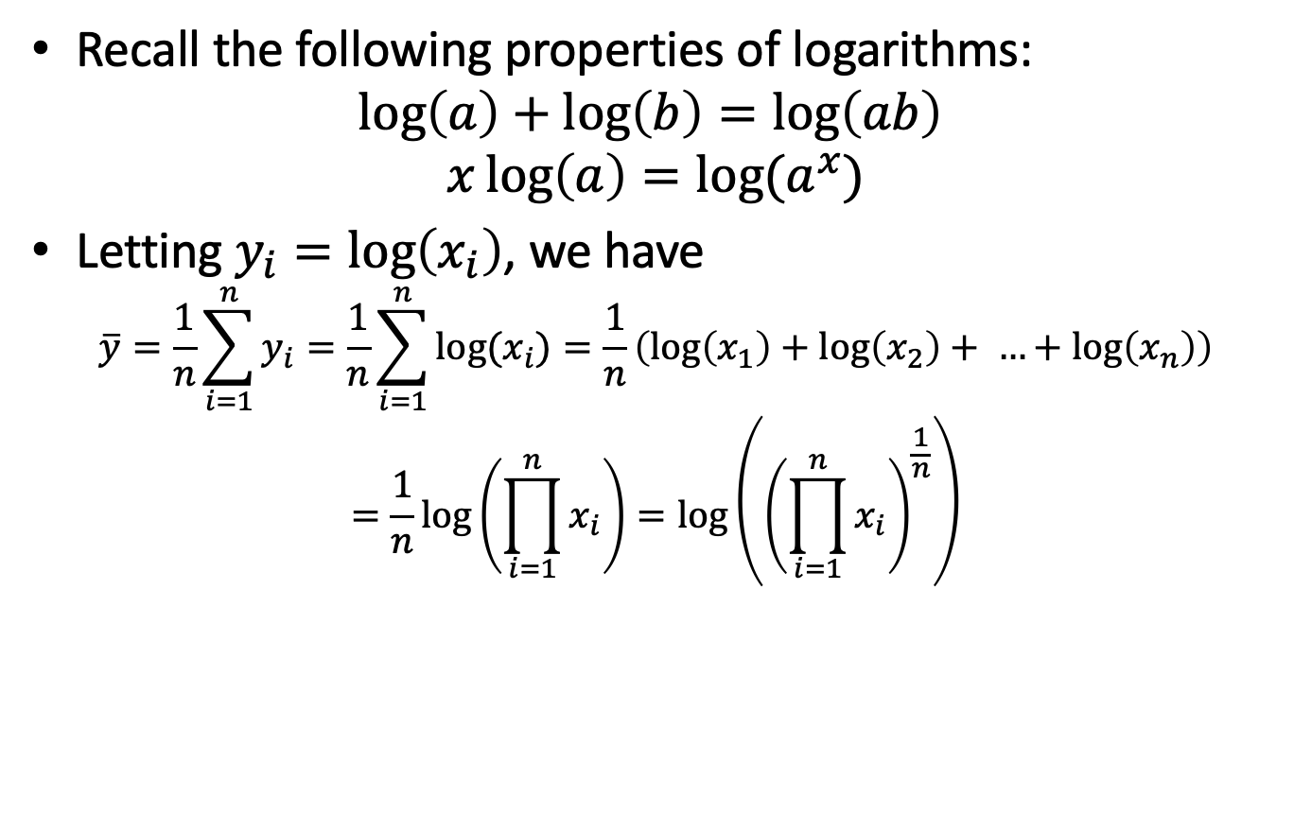
Interpreting inference on log-transformed data
Recall the following properties of logarithms:
$$\log\left(a\right)+\log\left(b\right)=\log\left(ab\right)$$
$$x\log\left(a\right)=log⁡(a^{x})$$
Letting $y_{i}=\log\left(x_{i}\right)$, we have
$$\overline{y}=\frac{1}{n}\sum_{i=1}^{n}{y_{i}}=\frac{1}{n}\sum_{i=1}^{n}{log⁡(x_{i})}=\frac{1}{n}\left(\log\left(x_{1}\right)+\log\left(x_{2}\right)+ …+\log\left(x_{n}\right)\right)$$
$$=\frac{1}{n}\log\left(\prod_{i=1}^{n}{x_{i}}\right)=\log\left({\left(\prod_{i=1}^{n}{x_{i}}\right)}^{\frac{1}{n}}\right)$$

Slide 13
Interpreting inference on log-transformed data
Recall the following properties of logarithms:
$$\log\left(a\right)+\log\left(b\right)=\log\left(ab\right)$$
$$x\log\left(a\right)=log⁡(a^{x})$$
Letting $y_{i}=\log\left(x_{i}\right)$, we have
$$\overline{y}=\frac{1}{n}\sum_{i=1}^{n}{y_{i}}=\frac{1}{n}\sum_{i=1}^{n}{log⁡(x_{i})}=\frac{1}{n}\left(\log\left(x_{1}\right)+\log\left(x_{2}\right)+ …+\log\left(x_{n}\right)\right)$$
$$=\frac{1}{n}\log\left(\prod_{i=1}^{n}{x_{i}}\right)=\log\left({\left(\prod_{i=1}^{n}{x_{i}}\right)}^{\frac{1}{n}}\right)$$
Note that this is the geometric mean of the data points

Slide 14
Interpreting inference on log-transformed data
Recall the following properties of logarithms:
$$\log\left(a\right)+\log\left(b\right)=\log\left(ab\right)$$
$$x\log\left(a\right)=log⁡(a^{x})$$
Letting $y_{i}=\log\left(x_{i}\right)$, we have
$$\overline{y}=\frac{1}{n}\sum_{i=1}^{n}{y_{i}}=\frac{1}{n}\sum_{i=1}^{n}{log⁡(x_{i})}=\frac{1}{n}\left(\log\left(x_{1}\right)+\log\left(x_{2}\right)+ …+\log\left(x_{n}\right)\right)$$
$$=\frac{1}{n}\log\left(\prod_{i=1}^{n}{x_{i}}\right)=\log\left({\left(\prod_{i=1}^{n}{x_{i}}\right)}^{\frac{1}{n}}\right)$$
So we see that the arithmetic mean of the log-transformed data is the log of the geometric mean of the original data.

Slide 15
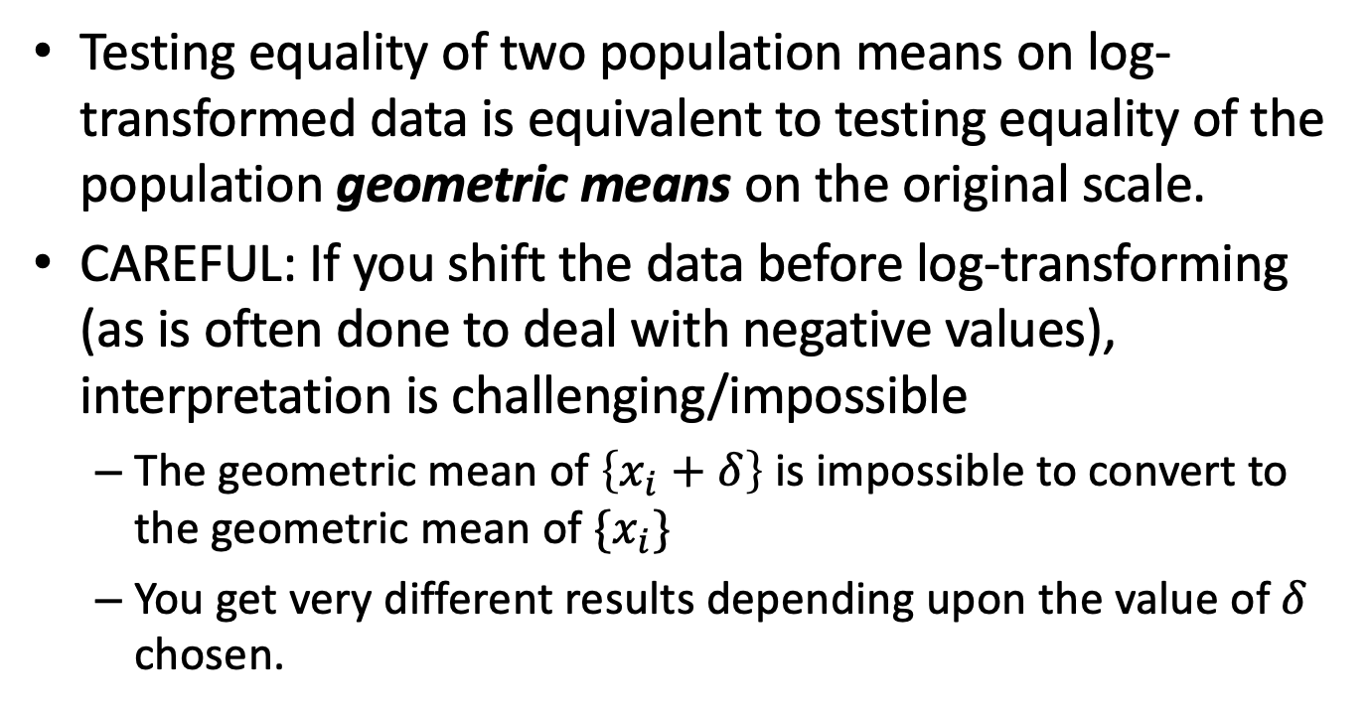
Interpreting inference on log-transformed data
Testing equality of two population means on log-transformed data is equivalent to testing equality of the population geometric means on the original scale.
CAREFUL: If you shift the data before log-transforming (as is often done to deal with negative values), interpretation is challenging/impossible
The geometric mean of $\left\{x_{i}+δ\right\}$ is impossible to convert to the geometric mean of $\{x_{i}\}$
You get very different results depending upon the value of $δ$ chosen.

